Slide 1
Run this as a slide show and click through to show the explanations for each slide.

Slide 2
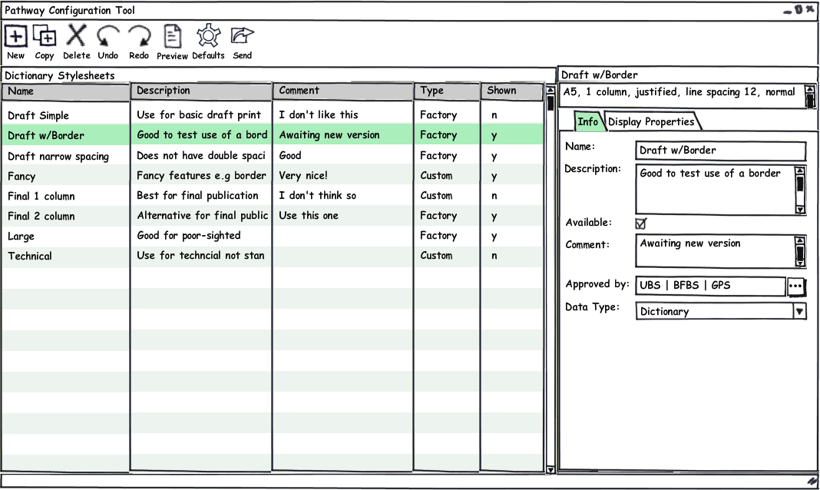
User can make copies, or start from scratch
The Configuration Tool comes with a set of protected* stylesheets.
*The “factory” stylesheets will not have editable Display Properties, but the Name, Description , Comment, availability etc. can all be altered.

Slide 3
Selected stylesheet is displayed on right for modification

Slide 4
The display properties* are summarized at the top.
Basic info* is grouped here
*I’m not deadset on the wording I’ve used. I’m just trying to get feedback on the general concept right now. If you like it, let’s discuss wording etc… ☺ I realize I may not have used the best words yet for various things.

Slide 5
Configuration person names stylesheet according to what end user will find helpful, and adds usage description.
Configuration person chooser whether this stylesheet will be shown to the end user or not. (Field label should be consistent with column heading…)

Slide 6
Factory stylesheets come with a list of who approves of them (publishers etc.)
Configuration person can add comment about the stylesheet for themselves.

Slide 7
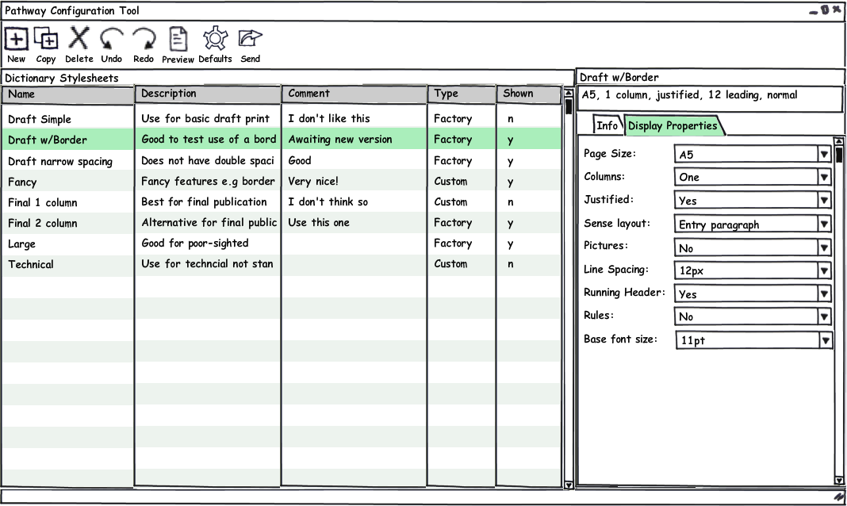
Display Properties are listed in this tab. (Not all shown in mock-up)
Wording here is purposeful avoidance of jargon. I think specialists can understand “line spacing” as being “leading”, but non-specialists may not understand what “leading” is.

Slide 8
User will be able to save and use stylesheet even if the values are “conflicting”, but they will be helped towards avoiding disapproved value combinations!
Conflicting properties are shown in red font and status bar will remind “Conflicting values shown in red”.

Slide 9
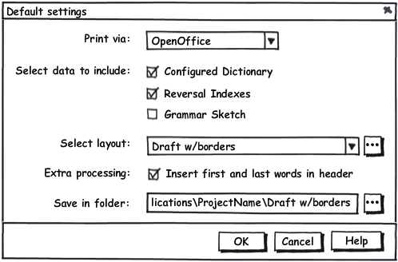
Set up the defaults shown in the ‘print via’ dialog (used in FLEx and WeSay etc.)
Something like this. Exactly the same dialog as is shown in FLEx etc BUT the task HERE is setting what is selected by default not actually exporting.

Slide 10
Opens preview of stylesheet’s layout. Proposal: ship a canned rich set of data which will be used for faster layout previews.
We could initially rely on an advanced user replacing the canned data file with their own for more relevant data previews. If demand was great, we’d build in an option to set your own preview data.

Slide 11
Package and send the settings set up in this tool (stylesheets and defaults) to someone else.

Slide 12
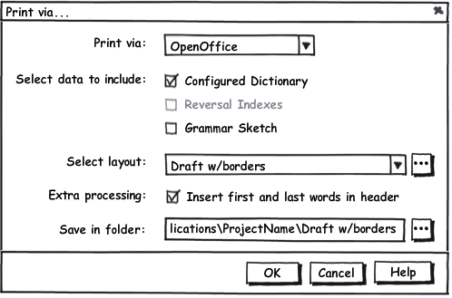
In FLEx File menu, supply option “Print via…” which opens this:
All the settings are pre-set in the Configuration Tool.
Data which is not present in the project will not be available.
The word ‘Stylesheet’ is purposely not used here, in order to avoid even this level of jargon for end users.
This controls whether macro is run in resulting document to insert the guide words.
Default folder should be: (My)Documents\Publications\CurrentProjectName\Dictionary\StylesheetName_Date
A additional toolbar button would provide a one click ‘print via’ function using the default settings. WeSay might only want to provide that kind of function.

Slide 13
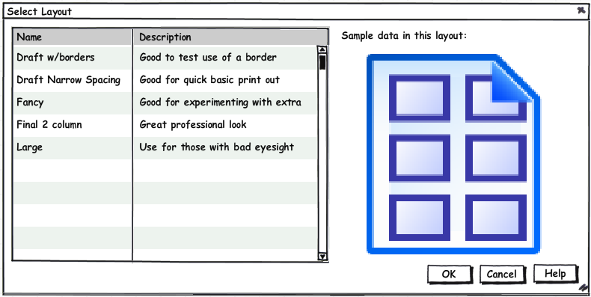
Only see stylesheets selected to be available.
Opens dialog with more details and preview.
I wonder if this extra dialog is not really necessary to implement initially?

Slide 14
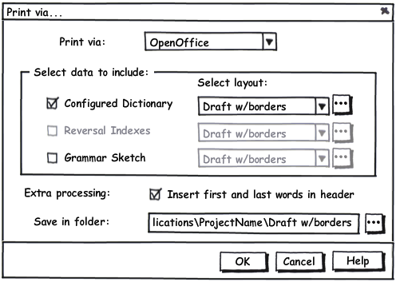
An alternative approach involves the potential selection of a different stylesheet for each set of data. This allows for different layouts to be selected for e.g. front matter and reversals etc. than for the main dictionary.

Slide 15
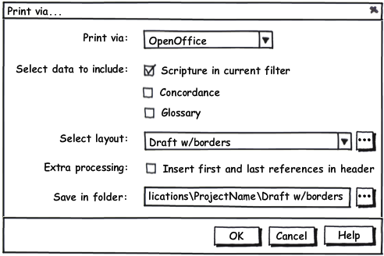
Other Considerations
We need either
Two ways to run the Configuration Tool so that the user sees either all the Dictionary stylesheets or all the Scripture ones, OR
Two views in the Configuration tool that show the list of the Dictionary stylesheets and the list of Scripture stylesheets
In either case, the Scripture stylesheets (and view or tool) must only be installed and visible if the user is interested in that kind of work… so there needs to be either two downloads (SE and BTE) or two installation options.
The Scripture plug-in dialog will have different data options (e.g. Scripture, Glossary, Concordance), and the appropriate subset of scripture stylesheets available:

Slide 16
Current Properties and values in Publishing Solution:
Justified: Yes, No
Page Size: Letter, A4, A5, C5, A6
Columns: 1, 2
Sense: Paragraph, Bullet
Example: No character, Callout
Writing System: No Separator, Separator
Language Tag: No, Yes
Font: Charis, Doulos, Sophia, Charis Compact
Font Size: 12, 10
Headword size: 14, 21, 10
Leading: 12, 14, 24
Embedded spans: field formatted, WS formatted, WS compact
Pictures: Yes, No
Running Head: Every page, Mirrored
Rules: Yes, No
Properties and values I want to rename:
Font Size → Base Font Size
Leading → Line Spacing
Running Head → First/Last Words (and its value)
Mirrored → Opposite Pages
Rules → Column divider line (and separately)
Header divider line
Properties I want to remove as should be handled in editing tool:
Sense: Paragraph, Bullet
Example: No character, Callout
Writing System: No Separator, Separator
Language Tag: No, Yes
Font: Charis, Doulos, Sophia, Charis Compact
Headword size: 14, 21, 10
Embedded spans: field formatted, WS formatted, WS compact

